Slide 1
TIGO PESA
CORPORATE SOLUTION
Online Payment

Slide 2
Tigo Secure - Introduction
Tigo secure is our new product which allows our customer to make payment online. Our solution is supported by our API and the connection is through VPN
This API is used to embed the Tigo Pesa payment option in a mobile or web based application, this allows for the secure payment for goods and services through Tigo Pesa
Download our API here Tigo_Online_Payment-API_Guide.pdf
No need to access the USSD to make payment
Integrated with your online systems
Your existing wallet can be used for Tigo Secure

Slide 3
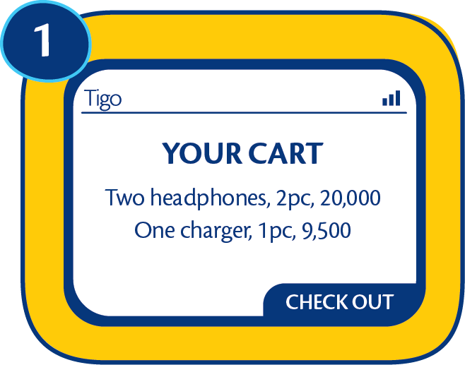
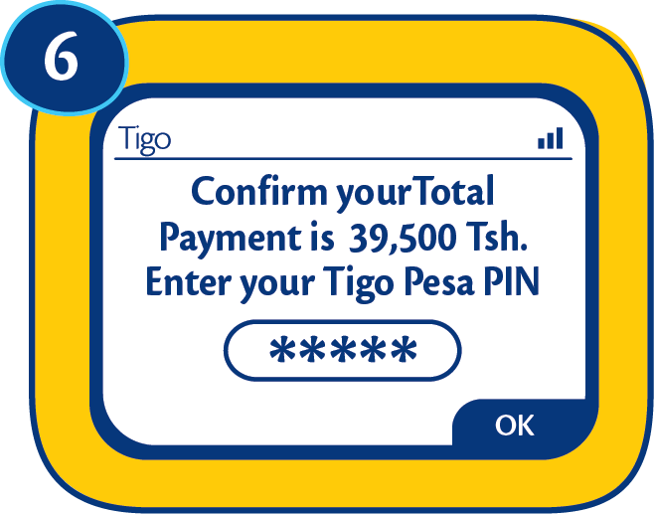
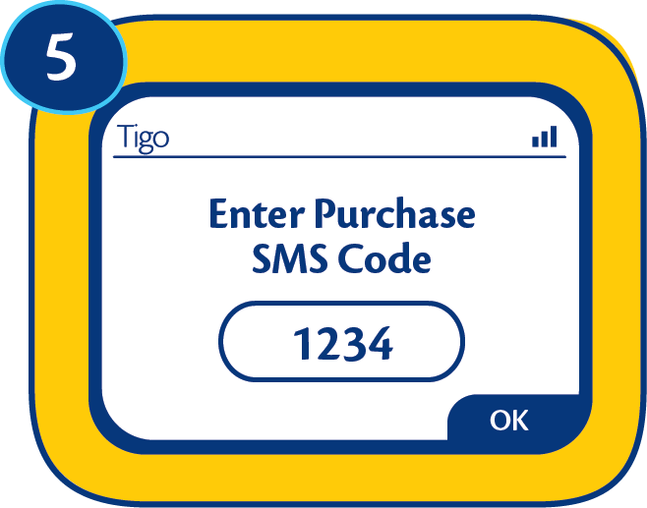
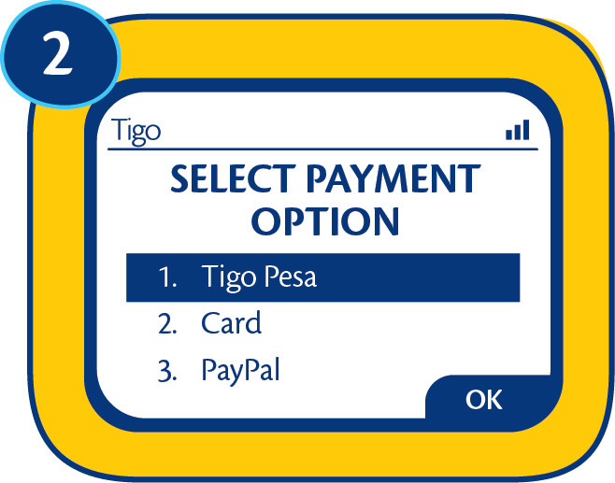
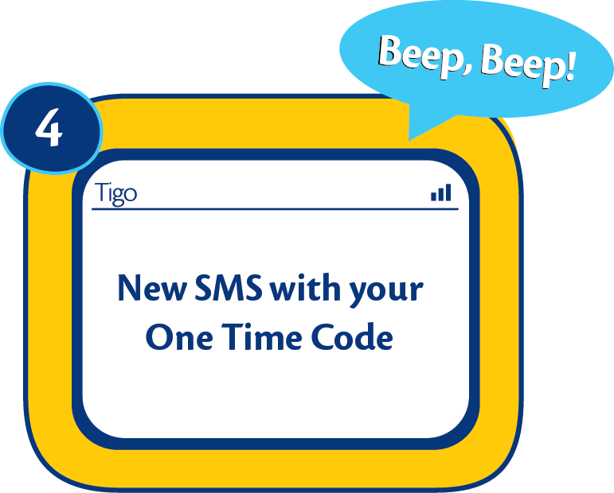
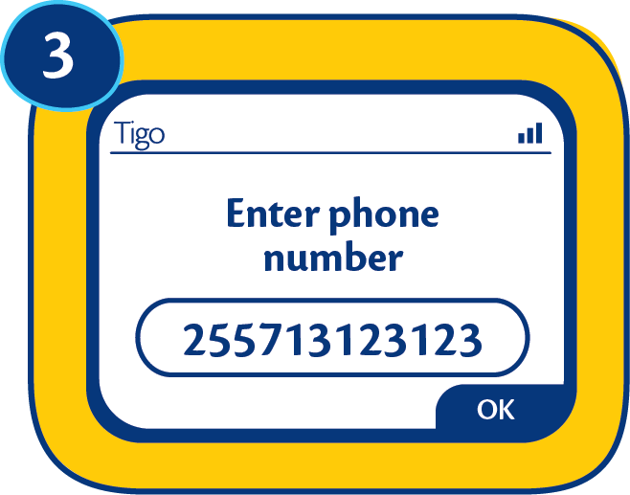
Tigo Secure - Process Flow
Customer access your online
website
Customer confirms the amount and enters Tigo
Pesa PIN
Customer chooses Tigo Pesa to make
payment
Customer enters the SMS code to your website
The customer enters his mobile number & immediately receives
an SMS with one time
code
(Expires after 3 minutes)

Slide 4
Why Tigo Pesa
Convenient and easy to use: Gives our customers access to money anywhere, anytime
Secure: More secure & flexible than cash, allowing consumers to make payments remotely and reduces cash handling
Financial inclusion: Migrates unbanked customers to Banked customers giving them an opportunity to become engaged in the formal banking sector
Opportunity: Customers can use the money to pay for their bills, buy goods, send money to friends and family.
Relevant: Customer’s payment made quick and easy
Affordability: Competitive rates, and reduces costs associated with cash transactions
Support: Corporate Sales Team offers you personalized Key Account Management through specialized and customer centric resources.
Quality: More value for money
Portfolio: We cater for all types of customers, from SMEs to large corporates
Widest coverage: 95% of Tanzania population
Innovation: The only MNO with a Mobile Money Application (Tigo Pesa App)

Slide 5

Thank You!

