Slide 1

A brief self-introduction
  Dàjiā hǎo！
  Wǒ shì Xiāo Juān。
  Wǒ shì nǐmen de zhōngwén lǎoshī。
  Qǐng jiào wǒ Xiāo lǎoshī， huòzhě Joly.
  Xièxie！
大家 好！
我 是 肖 娟。
我 是 你们 的 中文 老师。
请 叫 我 肖 老师, 或者 Joly.
谢谢！
Hello, everyone.
I am Xiao Juan.
I am your Chinese teacher.
Please call me Teacher Xiao, or Joly.
Thank you.
Would you like to introduce yourself in Chinese?
大家好！ Dàjiā hǎo！ Hello, everyone.
我是... Wǒ shì…. I am…
请叫我… Qǐng jiào wǒ … Please call me …
谢谢！ Xièxie！ Thank you.

Slide 2
有用的汉字学习网站和软件 the websites and apps that might be useful for you to learn Chinese characters
http://www.yes-chinese.com/tzg/
http://www.zdic.net/z/28/js/9910.htm
app: ChineasyCards
字典：Pleco

Slide 3
第一课 你好
Dì yī kè
Nǐ hǎo
Lesson 1
Hello!

Slide 4
nǐ
n
i
pīn yīn
拼音
(Syllables)
shēngmǔ
声母 (Initals)
yùnmǔ
韵母
（Finals）
Shēngdiào
声调
(Tones)
你
you
hàn zì
汉字
Chinese character

Slide 5

shēngdiào
声调
Tones
shēngmǔ
声 母
Initals
yùnmǔ
韵母
Finals
好
good
hàn zì
汉字
Chinese character

Slide 6
Phonetic System
Pīn yīn
拼音
(Syllables)

Slide 7
b p m f d t n l g k h j q x zh ch sh r z c s
声母 shēngmǔ (21 Initals)

Slide 8
韵母 yùnmǔ （39 Finals）
 | i | u | ü
a | ia | ua
o |  | uo
e | ie |  | üe
ai |  | uai
ei |  | uei(ui)
ao | iao
ou | iou(iu)
an | ian | uan | üan
en | in | uen(un) | ün
ang | iang | uang
eng | ing | ueng
ong | iong

Slide 9
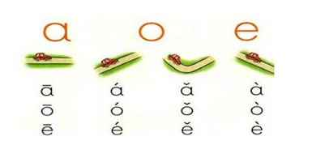
声调shēngdiào (Tones)
The Chinese Putonghua(mandarin) has four basic tones. They are shown by the tone marks as follows :e
1 声
2 声
3声
4声

Slide 10
Writing System
Hàn zì
汉字
Chinese character

Slide 11
汉字(hàn zì ) Chinese character
In Chinese, there are a great number of characters. But as a matter of fact, some characters are seldom used. Those that are widely used total around 5000 to 8000, and only 3500 characters are used in everyday life and covers 99.48% of characters appearing in books and newspapers. Among these some 3500 characters, about 950 are of the highest frequency of appearance, covering 90% of those printed in book and newspapers.

Slide 12
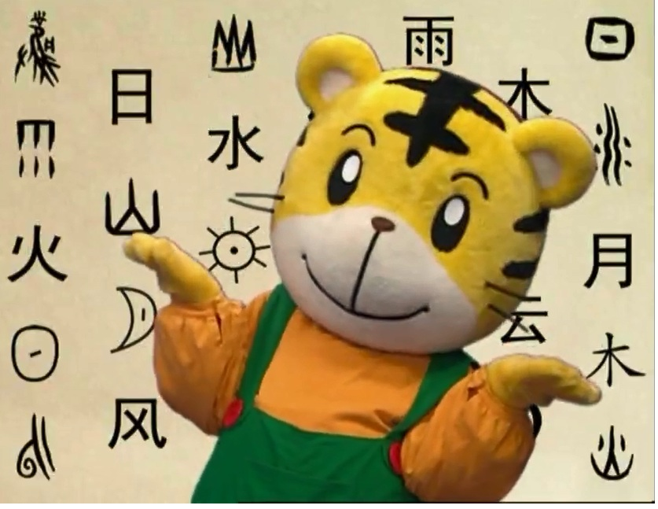
Follow me!

Slide 13
什么是汉字？ What are Chinese characters?
汉字是怎么来的？ Where do Chinese characters come from?
怎样学习汉字？ How to learn Chinese characters?

Slide 14
汉字(hàn zì ) Chinese character
What’s the difference between Chinese character learning and English learning?
网
honorificabilitudinitatibus
You may not know how to read a Chinese character but you can guess the meaning of the character according to how it is written.

Slide 15
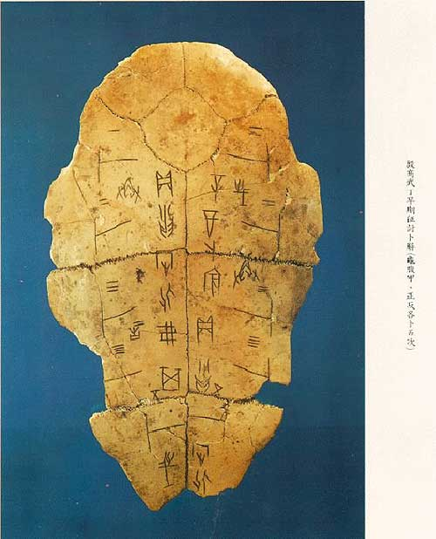
汉字(hàn zì ) Chinese character
Where do Chinese characters come from?
Oracle Bone Inscription

Slide 16
汉字(hàn zì ) Chinese character
How do Chinese ancients create Chinese characters?
象形字Pictographic characters
指事字Indicative characters
会意字Associative characters
形声字Pictophonetic characters (more than80%)

Slide 17
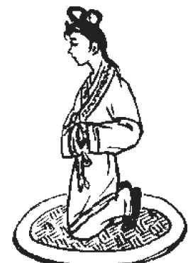
汉字(hàn zì ) —— 象形字Pictographic characters
How do Chinese ancients create Chinese characters?
nǚ
女

Slide 18
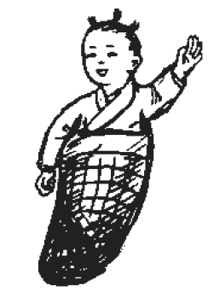
汉字(hàn zì ) —— 象形字Pictographic characters
How do Chinese ancients create Chinese characters?
zi
子

Slide 19
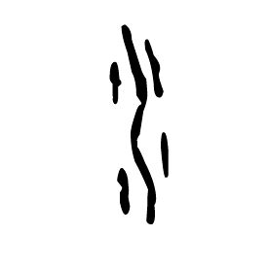
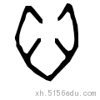
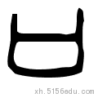
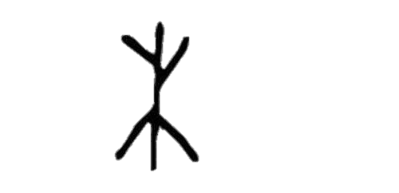

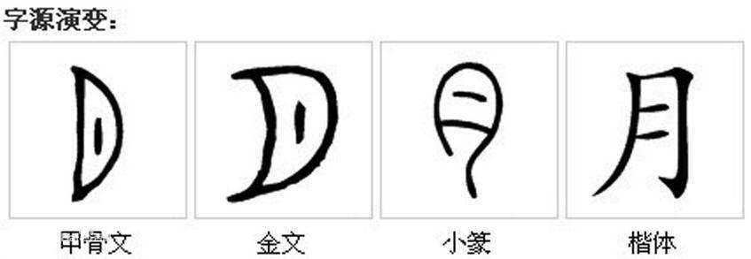
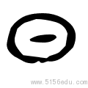
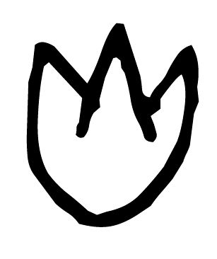
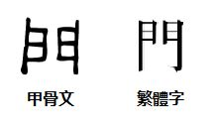
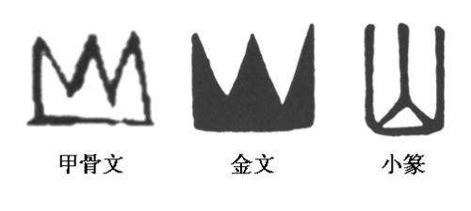
汉字(hàn zì ) —— 象形字Pictographic characters
How do Chinese ancients create Chinese characters?
sun
eye
mountain
heart
mouth
月
门
火
水
木
door
tree
water
moon
fire
山
口
日
目
心

Slide 20
汉字(hàn zì ) —— 象形字Pictographic characters
How do Chinese ancients create Chinese characters?
Chinese characters have had a history of more than 3000 years. Ancient Chinese characters were pictographic, outlining the rough shape of things with simple line.
What’s the differences between the pictographic characters and their modern version?
——The characters are no longer imitations of the things they
refer to, but in square forms.
——The soft lines have turned into solid strokes.

Slide 21

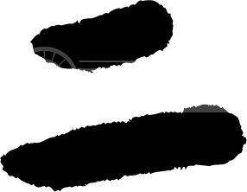
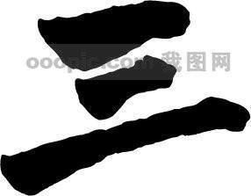
汉字(hàn zì ) —— 指事字 Indicative characters
Many things can hardly be drawn out in pictures, for they may be abstract in meaning or just part of a picture, which cannot be expressed by pictographs.
So how could ancient Chinese people do?
They used abstract symbols to indicate the meaning.
1
2
3

Slide 22
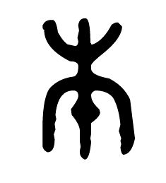
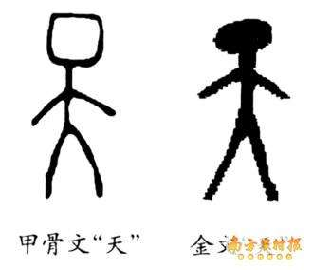
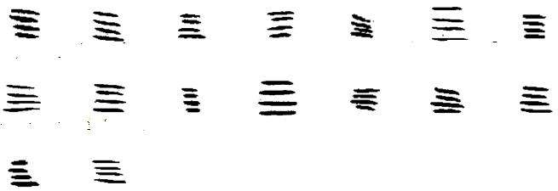
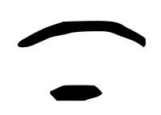
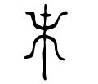
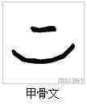
汉字(hàn zì ) —— 指事字Indicative characters
four
up; above
sky
root
end
down; under
天
下
四
上
本
末

Slide 23
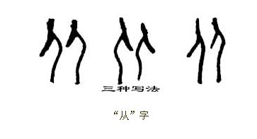
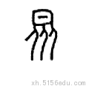
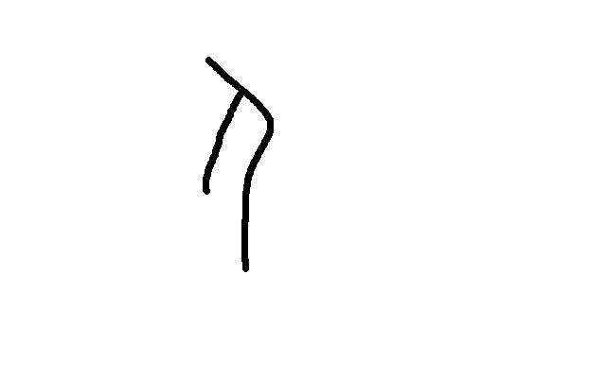
汉字(hàn zì ) —— 会意字 Associative characters
Ancient Chinese people invented pictographic characters to represent concrete things and the pictographic plus some symbols or strokes to refer to part of a thing or a certain direction and position.
Then how to express an abstract concept?
They worked out the idea of putting two or more pictographic characters side by side to describe an action, a process or something abstract.
人 rén
people
从
follow
众
many, crowd

Slide 24
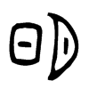
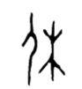
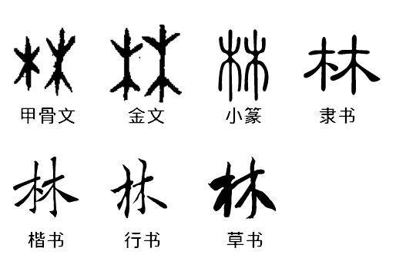
汉字(hàn zì ) —— 会意字Associative characters
休
林
明
好
bright
rest
good, nice
forest; woods

Slide 25
汉字(hàn zì ) —— 形声字 Pictophonetic characters
Even though Chinese is not a phonetic language, one component of the characters with two components can give indication to the sound, referred to as the phonetic radical, while the other conveys the meaning, termed the meaning radical. Characters of such make-up are called Pictophonetic characters.
Over 80% the Chinese characters we use today are Pictophonetic characters.
mā
nǚ
mǎ
妈
女
马
mom
woman,female
horse

